Slide 1
Regional Disparity in India
Dr. Pranjit Kumar Sarma

Slide 2
Meaning of Regional Disparities/Imbalances
Regional Imbalances implies that there is difference in ‘economic development’ of different regions. In India ‘region’ means a state or district or union territory. Regional imbalances may be inter-state or intrastate.
Regional imbalances or disparities means wide differences in per capita income, literacy rates, health and education services, levels of industrialization, infrastructural facilities etc. between different regions. Regions may be either States or regions within a State.

Slide 3
Regional Disparities/Imbalances
It refers to difference in economic development and uneven economic achievement in different geographical regions.
It is reflected by the indicators like per capita income, the proportion of population living below the poverty line, the percentage of urban population, percentage of population engaged in agriculture vis-à-vis engaged in industries, infrastructural development of different states.

Slide 4
Regional Disparities/Imbalances
The co-existence of relatively developed & economically depressed states and even regions within each state is known as regional Disparity or regional imbalance.
In general regional disparities or imbalances we meant wide differences in per capita income, literacy rates, availability of health and education services, levels of industrialisation, infra structural facilities etc between different regions.

Slide 5
Regional imbalances may be:
Natural Regional Imbalances: These are the imbalances in inter regional or intraregional development due to unequal distribution of natural resources by the nature. Each region is different from the other region in respect of natural resources, water capacity, forest etc.
Man Made Regional Imbalances: There may be some regions where more efforts have been made for development by giving preference for investment and other development efforts like – subsidies, grants, special status etc.

Slide 6
Types of Disparities/Imbalances
Global Disparity (Disparity between Nations)
Inter-State Disparity (Disparity between States)
Intra-State Disparity (Disparity within States)
Rural-Urban Disparity (Disparity between Rural & Urban

Slide 7
Causes of Regional Imbalances or Disparities in India:
Historical factors: British regime
Geographical factors : Natural factors
Failure of planning:
Financial:
Infrastructure
Disparities in Socio-Economic Development
Political
Predominance of Agriculture:
Lack of Motivation on the Part of Backward States
Locational Advantages

Slide 8
Indicators of Regional Imbalances in India
State Per Capita Income: States like Punjab, Haryana, Maharashtra, Gujarat, Karnataka, Tamil Nadu and Kerala have achieved higher per capita income when compared with Orissa, Bihar, M.P, UP, Assam and Rajasthan.
In 2016, Delhi’s per capita income stood at Rs. 2,01,083 as compared to Bihar’s Rs. 22,890.

Slide 9
Indicators of Regional Imbalances in India
Inter - State Disparities in Agricultural and
Industrial Development:
  Punjab, Haryana and part of U. P has recorded high rate of productivity due to its high proportion of irrigated area and higher level of fertilizer use.
  On the other hand, states like Assam. Bihar, Orissa and part of U.P. have been lagging behind in respect of the pace of industrialization

Slide 10
Indicators of Regional Imbalances in India
Intra-State imbalance:
  There is a growing tendency among most of the advanced states concentrate its development activities towards relatively more developed urban, and metro cities of the states while allocating its industrial and infrastructural projects by neglecting the backward areas.

Slide 11
Indicators of Regional Imbalances in India
Spatial Distribution of Industries:
  States like Punjab, Haryana, Maharashtra, Gujarat, Kerala, and Karnataka have achieved considerable development in its industrial sector. But West Bengal could not keep pace in its industrial growth as much as other industrially developed states.

Slide 12
Indicators of Regional Imbalances in India
Population below poverty line:
  The high rural poverty can be attributed to lower farm incomes due to subsistence agriculture, lack of sustainable livelihoods in rural areas, impact of rise in prices of food products on rural incomes, lack of skills, underemployment and unemployment. Total poverty (Rural & Urban) is more in M.P, Assam, Odisha, Arunachal Pradesh, Manipur, Jharkhand and Chhattisgarh.

Slide 13
Indicators of Regional Imbalances in India
Degree of Urbanization:
  In respect of urbanization the percentage of urban population to total population is an important indicator. The all India percentage share of urban population stands at 27.81% in 2001 and 31.6 in 2011.

Slide 14
Indicators of Regional Imbalances in India
Per Capita Consumption of Electricity:
  Punjab, Gujarat, Haryana, Maharashtra etc., having higher degree of industrialization and mechanization of agriculture, have recorded a higher per capita consumption of electricity than the economically backward states like Assam, Bihar, Orissa, Madhya Pradesh and Uttar Pradesh

Slide 15
Indicators of Regional Imbalances in India
Employment Pattern:
  Rajasthan etc. Maharashtra, Gujarat, Haryana, Punjab, Tamil Nadu and West Bengal are maintaining a higher average daily employment of factory workers per lakh of population as compared to that of lower average maintained in industrially backward states like Assam, Orissa, Uttar Pradesh

Slide 16
Indicators of Regional Imbalances in India
Foreign Direct Investment:
  High FDI States: Maharashtra, Dadra nagar Haveli, Daman & Div, Delhi, Haryana, Tamilnadu, Pondicherry, Karnataka, Gujarat, Andhra Pradesh.
  Medium FDI States: West Bengal, Sikkim, Andaman & Nikobar islands, Rajasthan, Chandhighadh, Punjab, Haryana, Himachal Pradesh, Madhya Pradesh, Chatiishghadh, Kerala, Lakshadweep.
  Low FDI States: Goa, Orissa, UP, Uttaranchal, Assam, Arunachal Pradesh, Manipur, Meghalaya, Mizoram, Nagaland, Tripura, Bihar and Jharkhand.

Slide 17
Indicators of Regional Imbalances in India
Human Development Index:
  It is a composite statistic of life expectancy, education, and income per capita indicators. It is also an important indicator of regional disparities.
  Kerala, Delhi, H.P, Goa, Punjab are very highly developed. NE (excluding Assam), Tamilnadu, Haryana, J&K, Gujarat, Karnataka are highly developed.
  West Bengal, Uttarakhand, Andhra Pradesh, Assam, Rajasthan are medium developed. UP, Jharkhand. M.P, Bihar, Chhattisgarh are low developed, which clearly shows regional imbalances between the States in India.

Slide 18
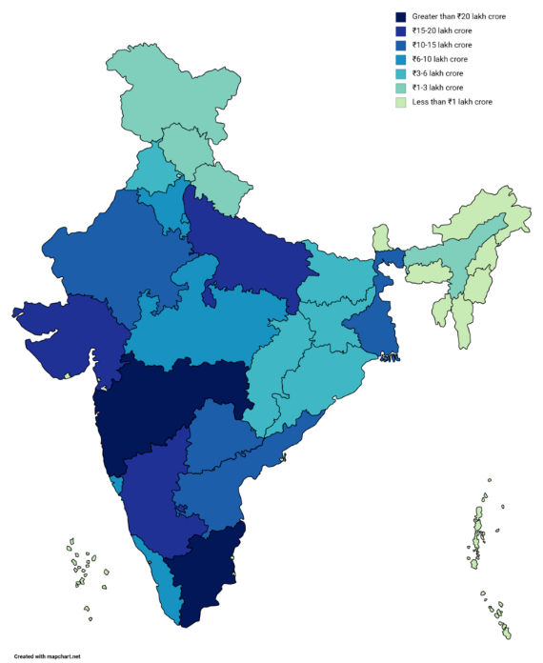
State Wise GDP Pattern

Slide 19
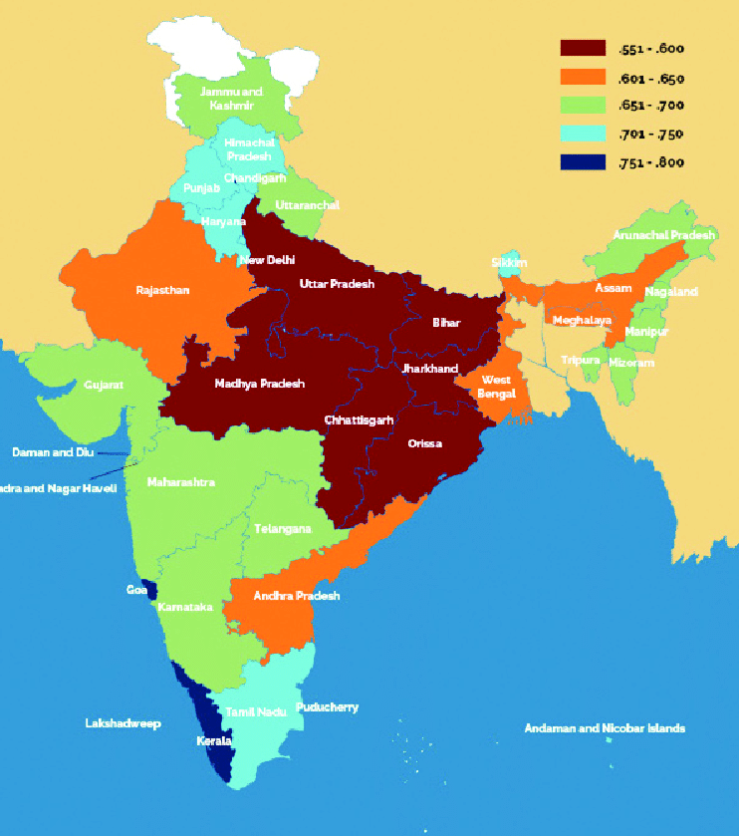
HUMAN DEVELOPMENT INDEX IN INDIAN STATES

Slide 20
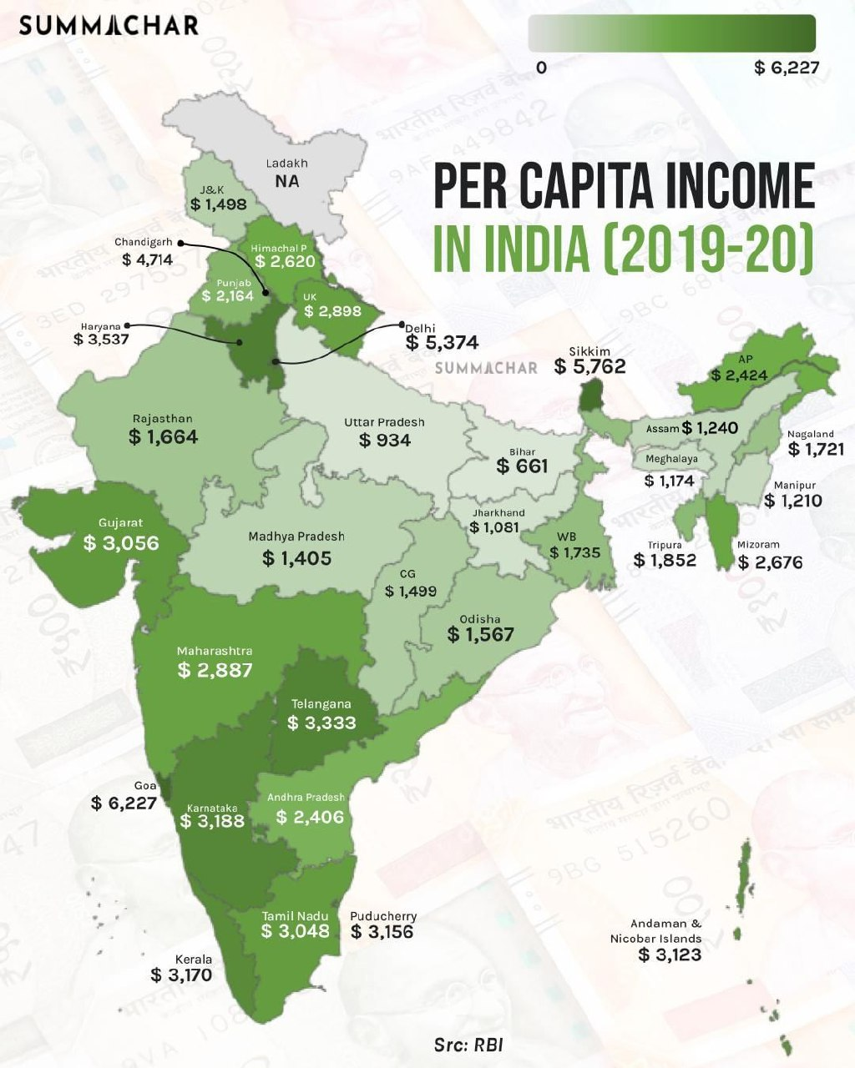

Slide 21
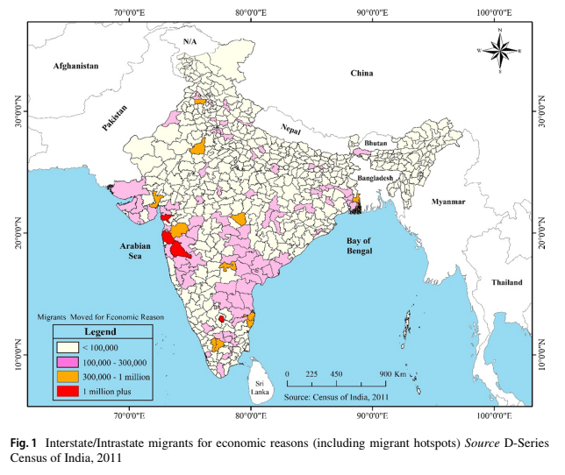

Slide 22
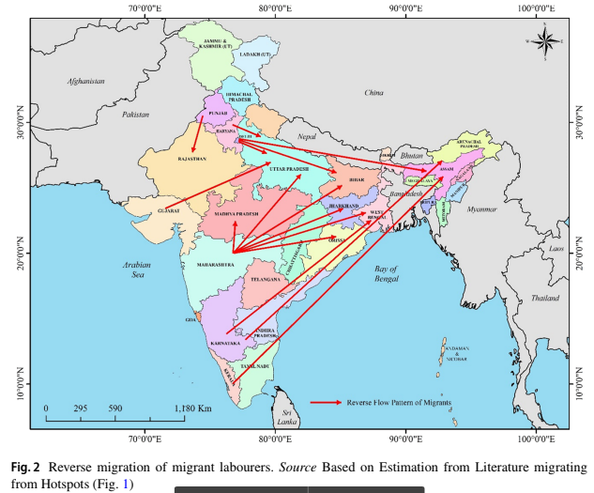

Slide 23
Consequences of Regional Imbalances
Inter-States and Intra State Agitations:
Migration:
Social Unrest:
Pollution:
Housing & Water Problem:
Frustration among Rural Youth:
Under-Developed Infrastructure:

Slide 24
Suggestions:
Identification of the Backward Areas and Allocation of funds:
Need for Investments in Backward Areas:
Good Governance:
Political Will:
Incentives:
Promoting New Financial Institution in Backward Region:
Setting Up of Regional Boards:
Growth Corridors:

Slide 25
Suggestions:
Strict restrictions on usage of productive agricultural lands for non-agricultural purposes to be implemented. If required, permissions for non-agricultural usage should be granted only after the farmers have been guaranteed a better life.
Usage of natural resources for the development of tribal areas to be implemented. There should be guaranteed share for the tribals in the income generated from the use of natural resources.

Slide 26
Conclusion:
Regional imbalance is a threat to the goal of inclusive growth and reduction of poverty.
The growing regional disparities have dampened the speed of further economic reforms, and hence may pose a barrier to India’s future economic growth.
Regional disparities will result in regional tensions, which in turn may lead to popular agitations and at some times militant activities also.
Regional disparities in economic and social development which exist within some of the States due to the neglect of certain backward regions have created and creating demand for separate S
tates like in the past for separate Telangana and now and then for Vidhrbha and for Bodo land. As such, there is a strong need for strengthening of good governance in the backward areas.
Towards this end, it is necessary that the local bodies in the backward areas are empowered and strengthened to reduce the regional imbalances in the country

